Slide 1
Comprehensive Digital Marketing for Axis Bank

Slide 2
Presented by : TEAM ID : LTVIP2024TMID10130 1. VADLA CHARAN 2. GOOTY MOULA HUSSAIN 3. VAMSARAJ CHANDRAKANTH 4. B.R.VISHNU KANTH 4. DASARI BHARATH KUMAR 5. DUDEKULA SUBHANALLAH From : S.S.G.S DEGREE COLLEGE Guntakal.

Slide 3
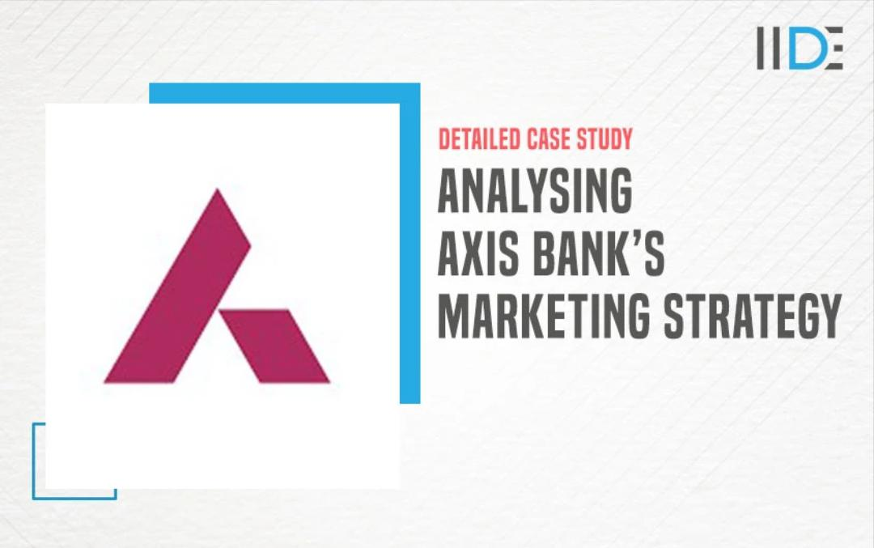
Part 1 : Brand study, Competitor Analysis & Buyer’s/Audience‘s persona
Research Brand Name : “AXIS BANK”

Slide 4
History of Axis Bank : The bank was founded on 3 December 1993 as UTI Bank, opening its registered office in Ahmedabad and a corporate office in Mumbai.^{[11]} The bank was promoted jointly by the Administrator of the Unit Trust of India (UTI),^{[12]} Life Insurance Corporation of India (LIC), General Insurance Corporation, National Insurance Company, The New India Assurance Company, The Oriental Insurance Corporation and United India Insurance Company. The first branch was inaugurated on 2 April 1994 in Ahmedabad by Manmohan Singh, then finance minister of India.

Slide 5
In 2001 UTI Bank agreed to merge with Global Trust Bank, but the Reserve Bank of India (RBI) withheld approval and the merger did not take place. In 2004, the RBI put Global Trust under moratorium and supervised its merger with Oriental Bank of Commerce. The following year, UTI bank was listed on the London Stock Exchange.^{[14]} In the year 2006, UTI Bank opened its first overseas branch in Singapore. The same year it opened an office in Shanghai, China. In 2007, it opened a branch in the Dubai International Financial Centre and branches in Hong Kong.

Slide 6
On 30 July 2007, UTI Bank changed its name to Axis Bank.[16] In 2009, Shikha Sharma was appointed as the MD and CEO of Axis Bank.[17] In 2013, Axis Bank’s subsidiary, Axis Bank UK commenced banking operations.[18] On 1 January 2019, Amitabh Chaudhry took over as MD and CEO.[19] In year 2021, the Bank had reduced its stake in Yes Bank from 2.39 per cent to 1.96 per cent

Slide 7
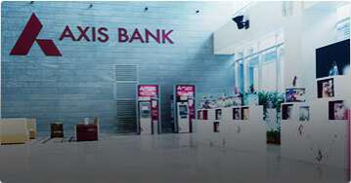
Mission : To be the preferred financial services provider excelling in customer service delivery through insight, empowered employees and smart use of technology.

Slide 8
Values : - The core values that reflect across the policies and decisions of the Bank comprise: Customer Centricity Ethics Transparency Teamwork Ownership USP : The Unique Selling Proposition (USP) of Axis Bank is its commitment to providing a wide range of financial products and services to meet the diverse needs of its customers.

Slide 9

AXIS Bank Identity : The logo uses the alphabet ‘A’ from the word Axis. The logo depicts a strong growth path for the bank supported by a strong base, indicating that the bank is moving on from a position of strength. Earlier, the bank’s logo used the letters U, T and I. “Our central message is that nothing has changed except the name

Slide 10
smart goals : Increase the sales and profits in the next three quarters. • Increase the sales over next three quarters by 30% over the same quarters last year. • Increase the sales by 30% over last year sales during the same time period by increasing advertising budget. • Increasing the same stores sales by 30% over a specific time period using similar advertising budget.

Slide 11
Competitor Analysis : Axis Bank competitors include IDBI Bank, ICICI Bank, HDFC Bank Limited, Farmers & Merchants Bancorp and Hanmi Financial Corporation. Axis Bank ranks 4th in CEO Score on Comparably vs its competitors.

Slide 12

Part 2 : SEO & Keywords Research
SEO Audit :

Slide 13
Axis bank is promoting its offers and products aggressively through different channels. These include print advertisements, TVC, and digital marketing channels. Axis Bank also gives discounts and offers to its customers on interest rates and gift hampers in lucky draws for those who take loans.

Slide 14
Part 3 : content Idea’s and marketing strategy
Content ideas and marketing strategstrategies
Axis Bank Marketing strategy :
Axis bank is promoting its offers and products aggressively through different channels. These include print advertisements, TVC, and digital marketing channels. Axis Bank also gives discounts and offers to its customers on interest rates and gift hampers in lucky draws for those who take loans.

Slide 15
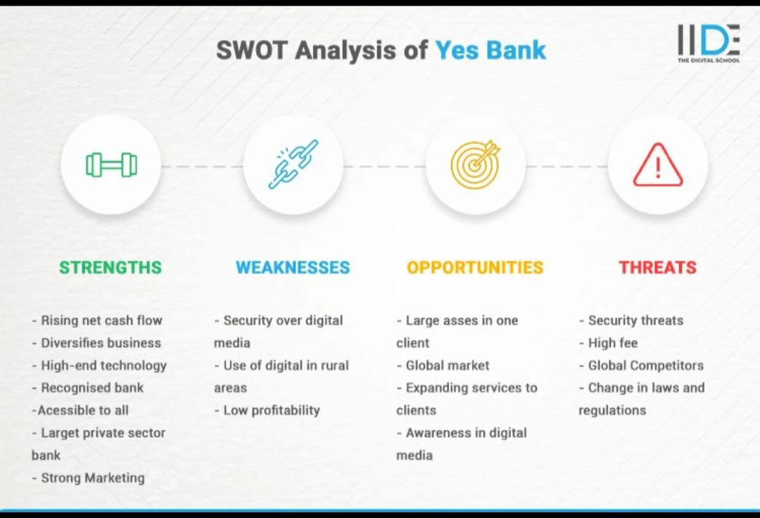
Swot Analysis of Axis Bank :

Slide 16
Instagram Story : Account link : https://www.instagram.com/bank_no_1?igsh=MWN4dTBxOWl6ZnhwbA== Day 1 Story link : https://www.instagram.com/stories/bank_no_1/3350497694026978619?utm_source=ig_story_item_share&igsh=ZDNqaGI5MGF1NzBy Day 2 Story link : https://www.instagram.com/stories/bank_no_1/3350497747898496990?utm_source=ig_story_item_share&igsh=MTB0ZzZqNHRiZ291NA==

Slide 17

Video of Axis

Slide 18
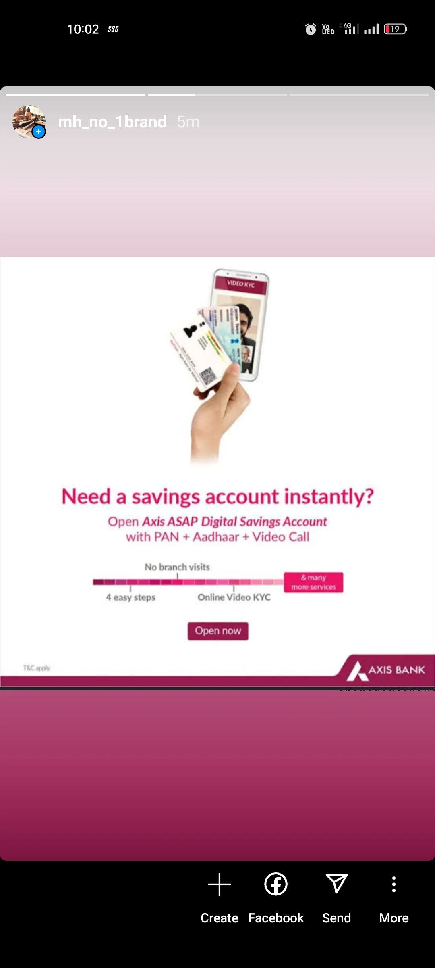
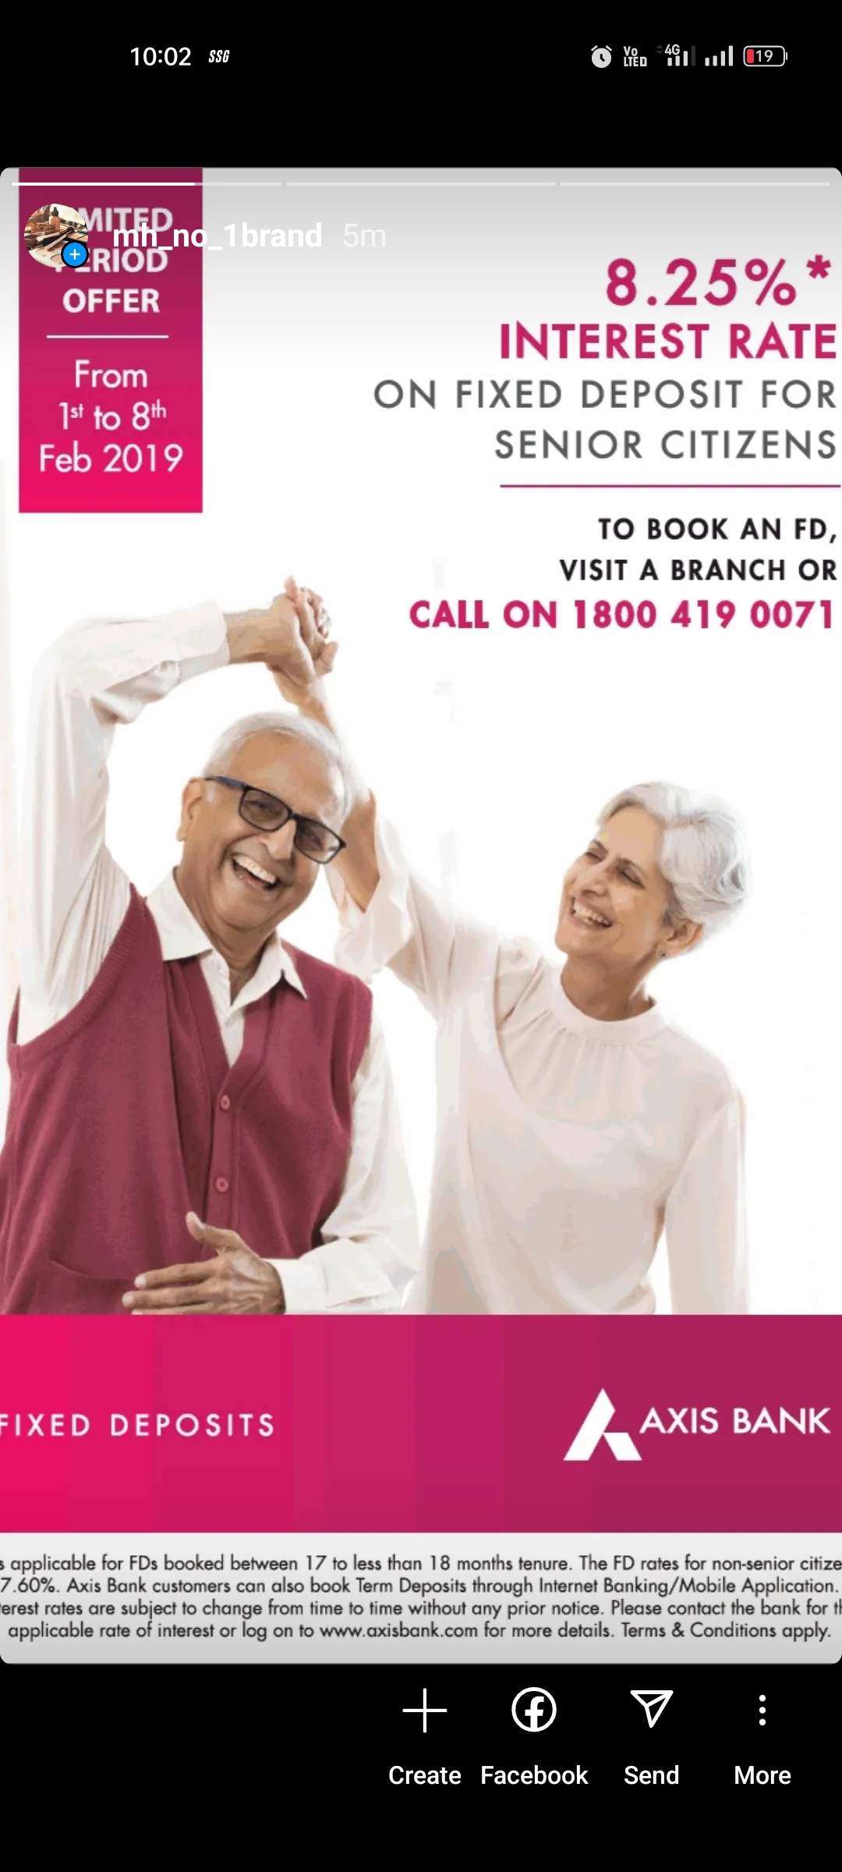
Instagram Story Screenshots : Day 1 : Day 2 :

Slide 19
GOOTY MOULA HUSSAIN My contribution to the project : As a Member I planed the process of project and l assigned topics to my team members and guid them . I worked to collect the Brand study ,buyers audience persona and competitor Analysis and gathered the data to my project .In the process of working on my project I learned so many new things that I never knew before it will help me to explore more about the new topics and inspired me to work more .

Slide 20
Team members-1 Subhan Allah My contribution in this project : I am one of the member of this project . I was assigned to Research SEO Audit , Keyword Research and to prepare the PPT presentation . In this process I learnd new things through the Research and want to explore more about the different platforms on Digital Marketing to build my skills .Through this project I learned so much practical experience to get selfknowledge in different paths and it’s show me what I am and increase my self confidence to achieve anything what I want .

Slide 21
Team member-2 VADLA Charan My contribution in this project : In this project I worked to make instagram reels , video editing to show my editing skils on this project through this project I know about different platforms on social media marketing and how to campaign different content to attract the customer .

Slide 22
Team members-3 BR .VISHNU KANTH My contribution in this project : In this project I worked to collect the content formats. In this process I am addicted to know and curious about latest news and to learn more about the different paths . It will help to perform better in given project and give my 100 percent effort on them.

Slide 23
Team members-4 DHASARI BHARATH KUMAR My contribution in this project : In this assigned project I worked to gathered data about marketing strategies about Amul and challenges facing the brand this helps me to learned about the top brands strategies and the digital marketing campaign on social media and strategies that are using increase marketing sales it will help me to increase my skills in this platform.

Slide 24
Thank you

